Slide 1
Project -3
Reader/Writer Locks
Raaga Sai Somesula

Slide 2
OBJECTIVE
Design and Implement readers/writers lock using semaphores
Do not starve the readers
Do not starve the writers
Set of input scenarios that show the behavior of the non-starving lock compared to the starving lock.

Slide 3
Readers-Writers Problem: Definition
A data set is shared among a number of concurrent processes
Readers – only read the data set, they do not perform any updates
Writers – can both read and write
Problem – allow multiple readers to read at the same time.
Only one writer can access the shared data at the same time.
Several variations of how readers and writers are considered all involve some form of priority.

Slide 4
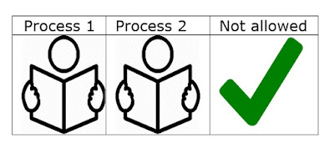
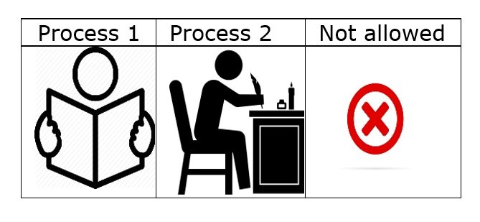
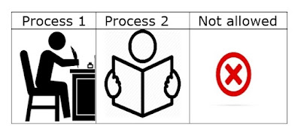
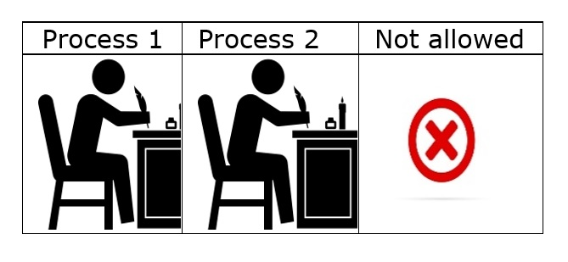
Readers-Writers Problem: Locking Table

Slide 5
Shared Data
The buffer itself
Integer read_count initialized to 0, tracks the number of readers currently reading from the buffer.
Semaphore rw_mutex, initialized to 1, ensures exclusive access to the buffer by either one writer or multiple readers.
Semaphore r_mutex, initialized to 1, guards the read_count variable shared by readers.

Slide 6
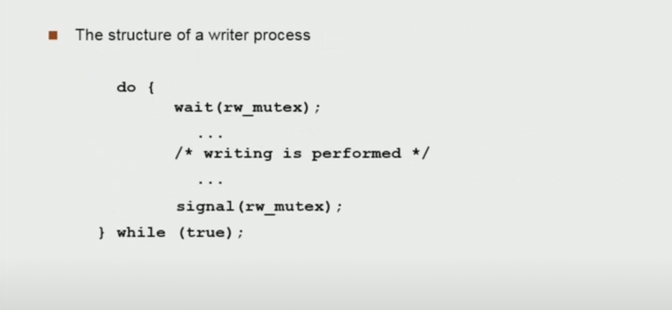

Slide 7
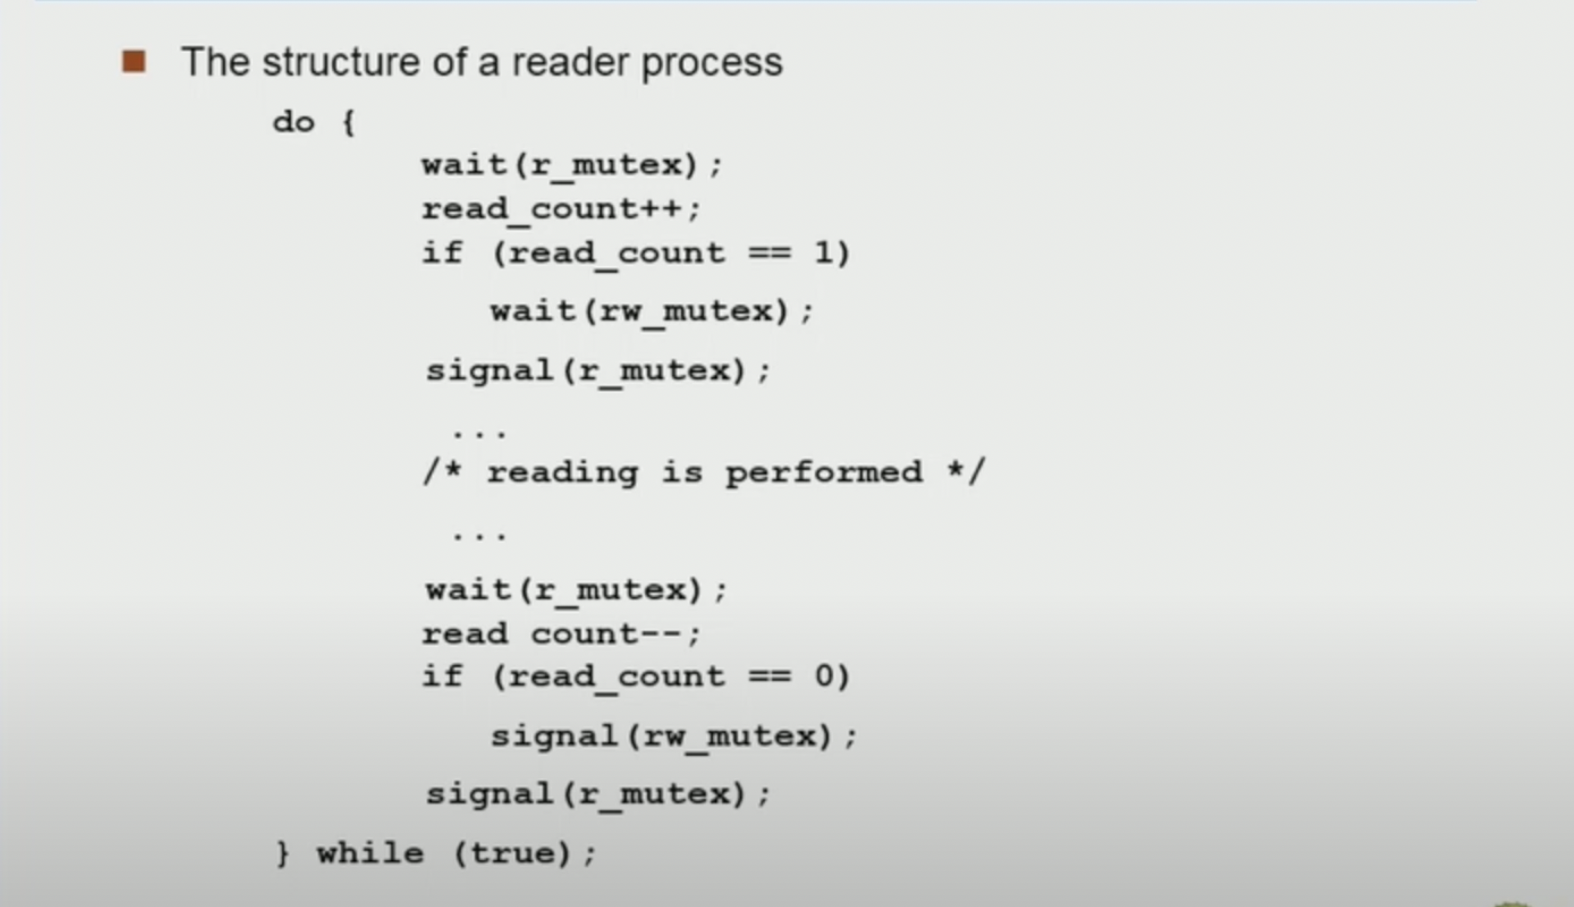

Slide 8
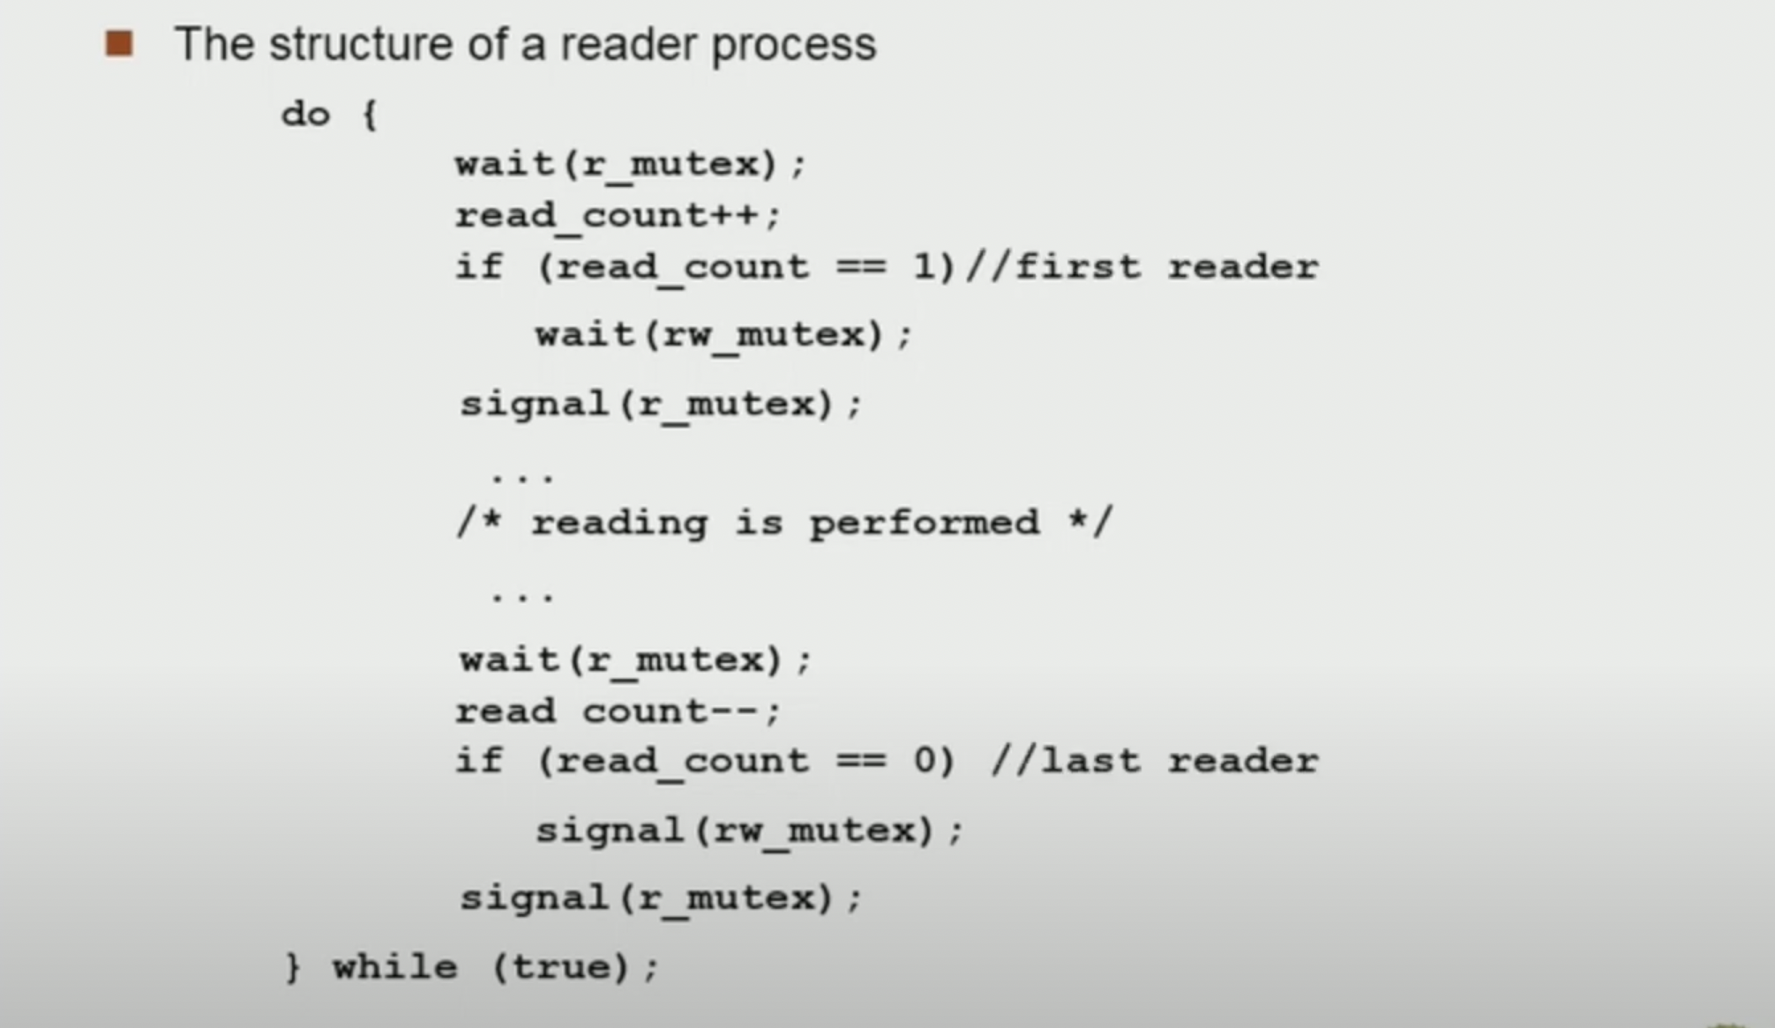

Slide 9
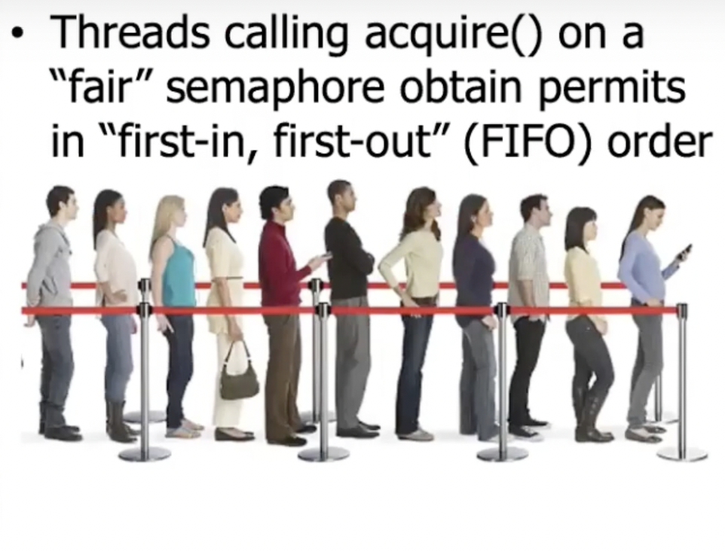
Fairness setting in Semaphore

Slide 10
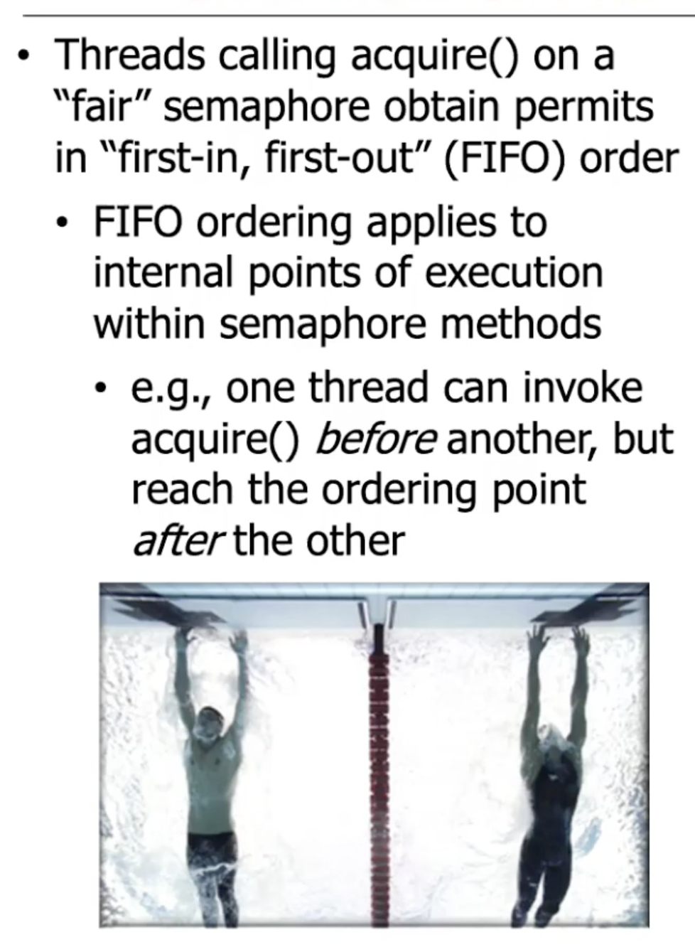

Slide 11
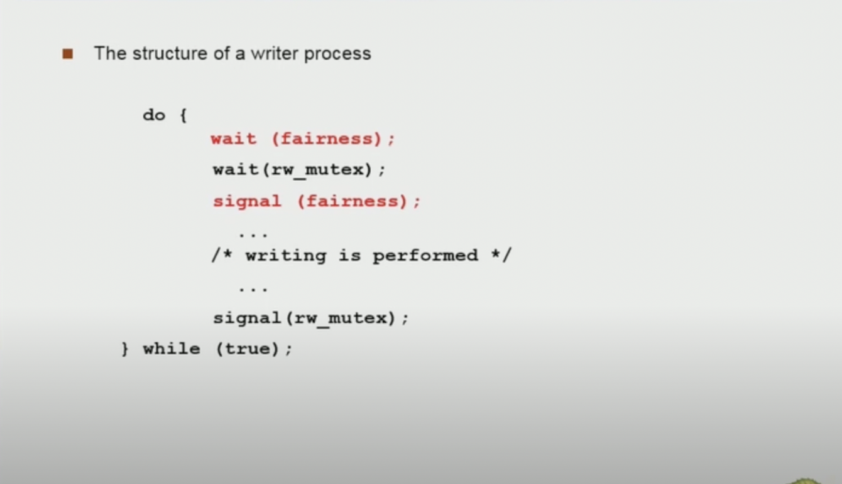
Readers and Writers Problem solution without Starvation

Slide 12
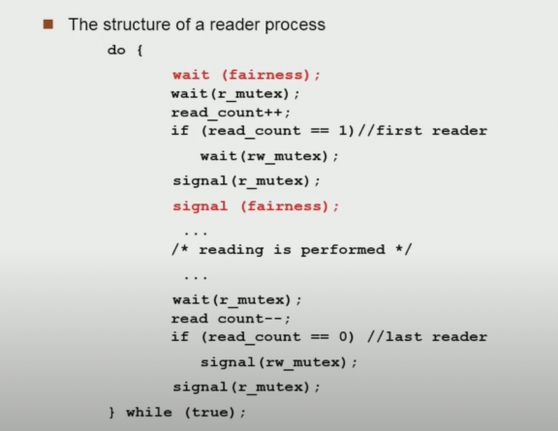

Slide 13
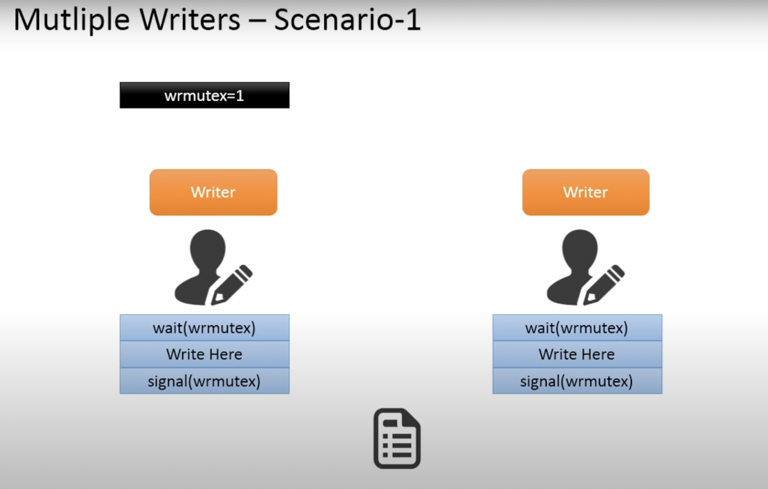

Slide 14
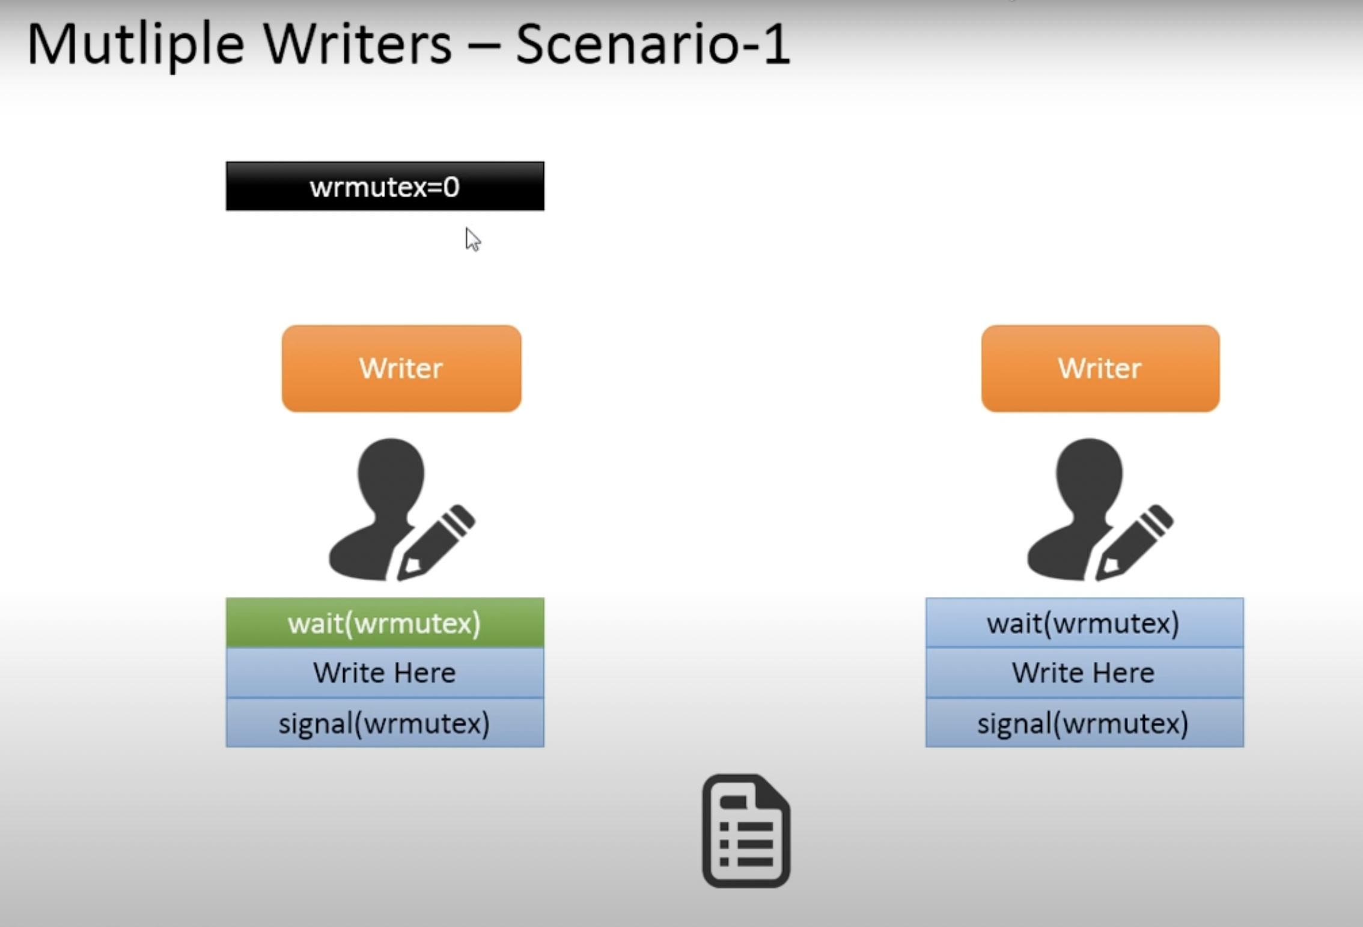

Slide 15
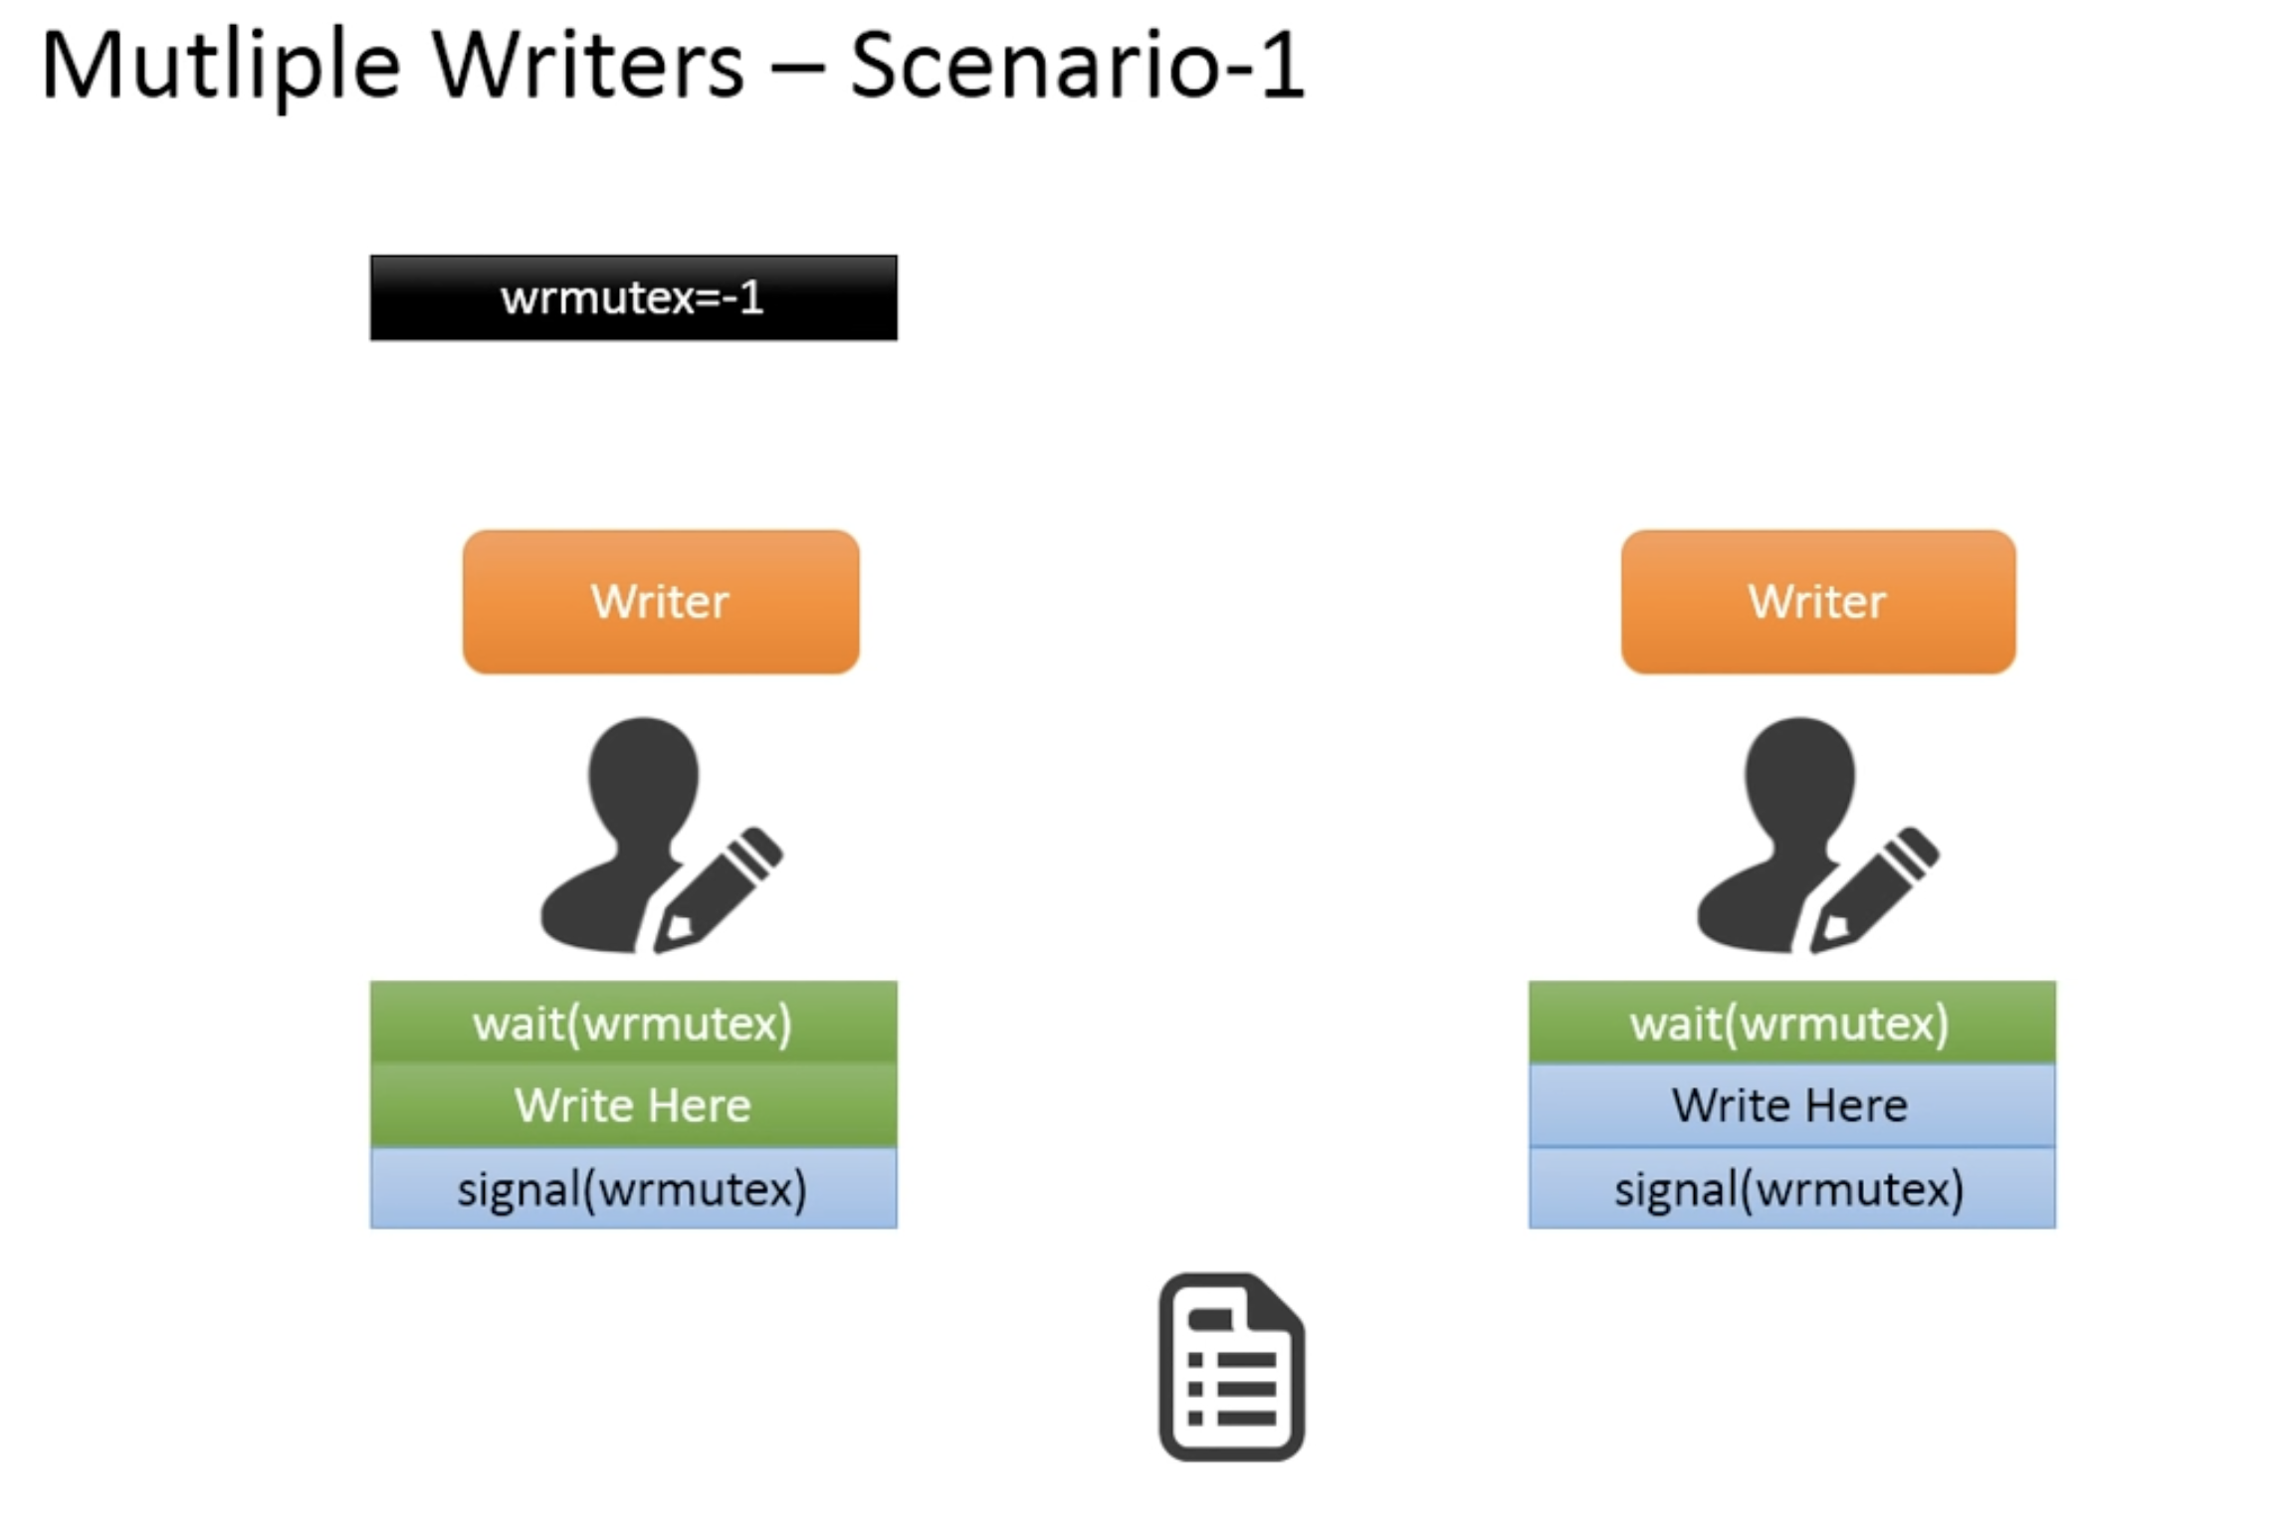

Slide 16
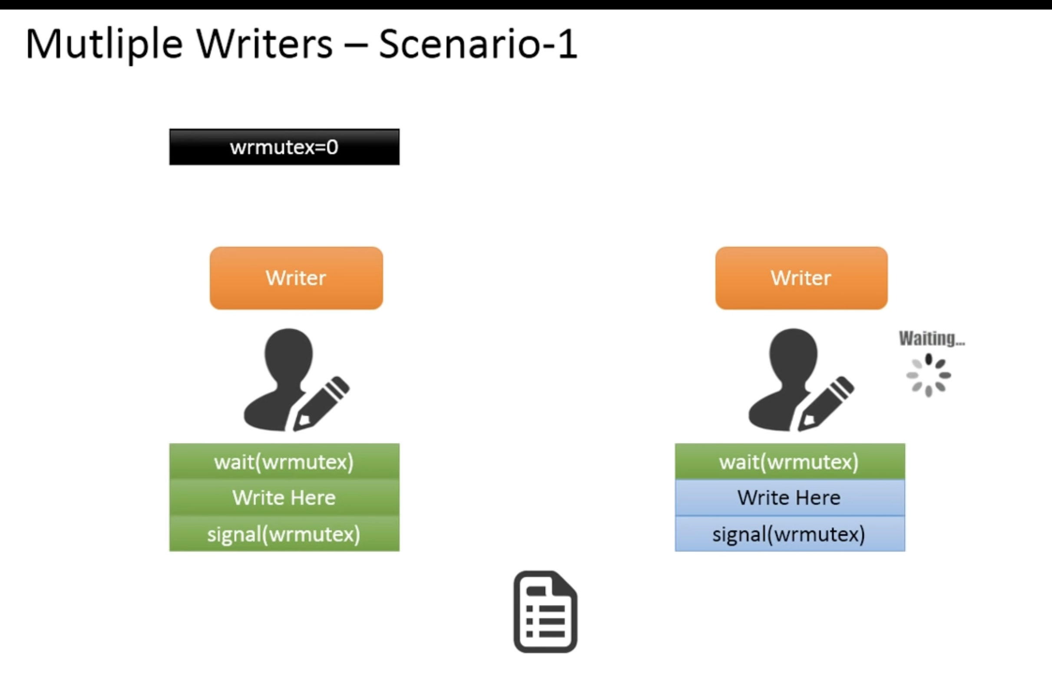

Slide 17
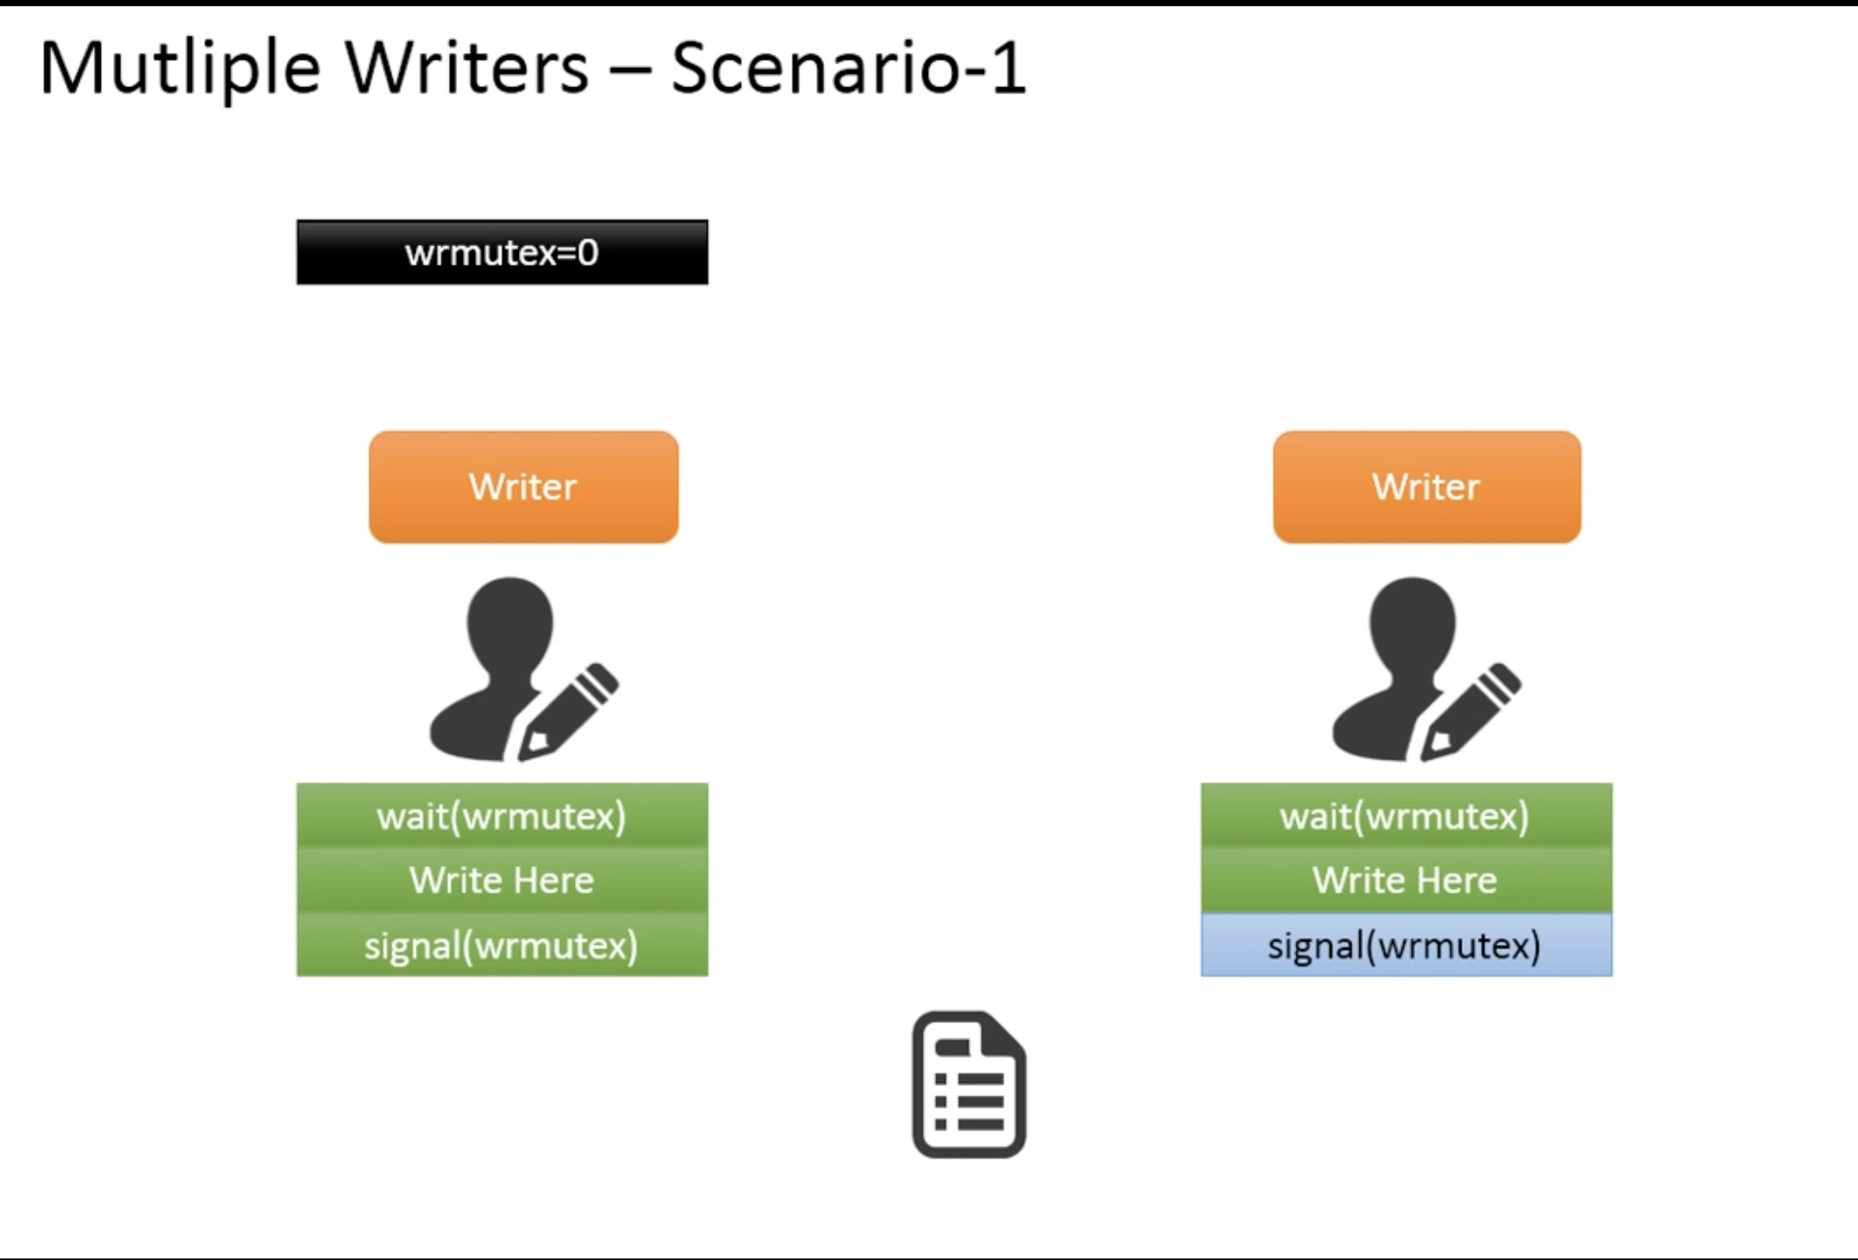

Slide 18
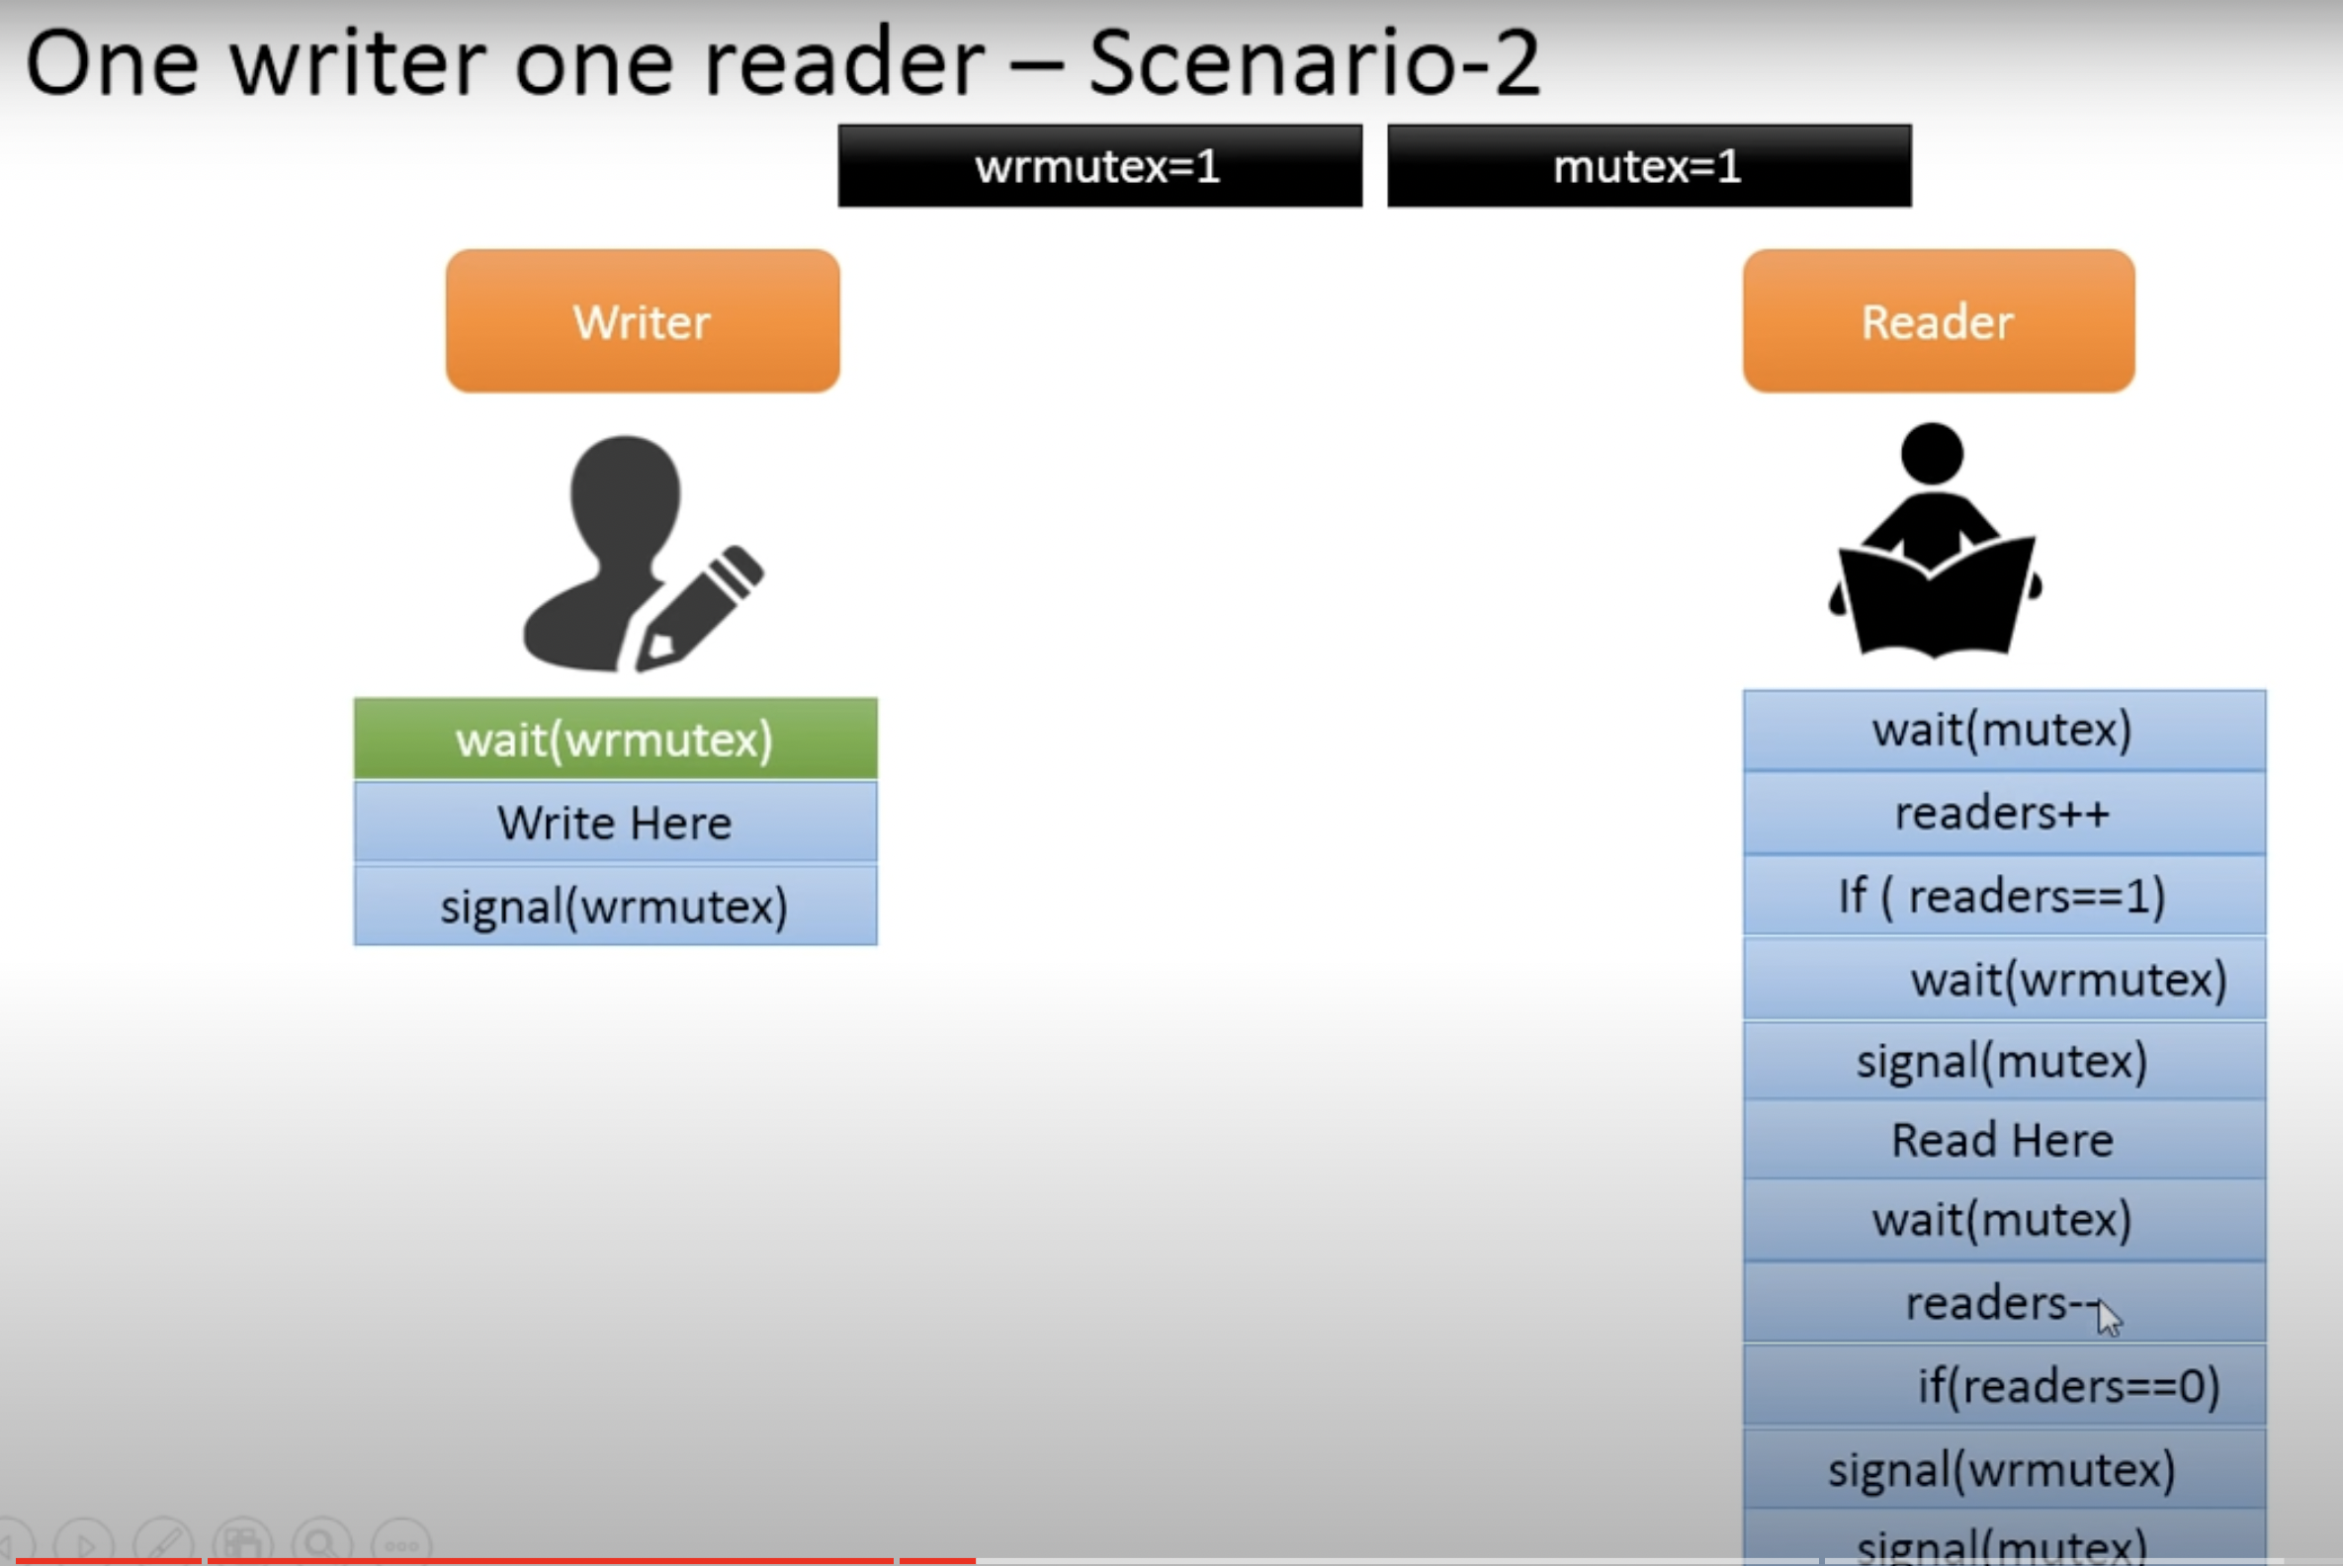

Slide 19
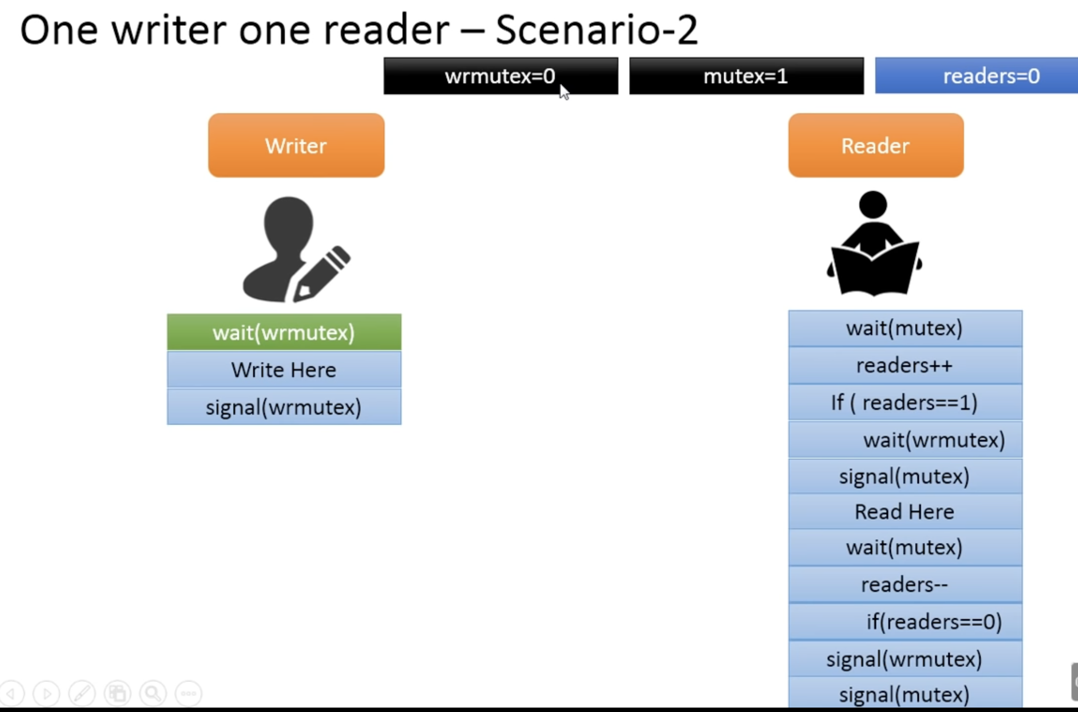

Slide 20
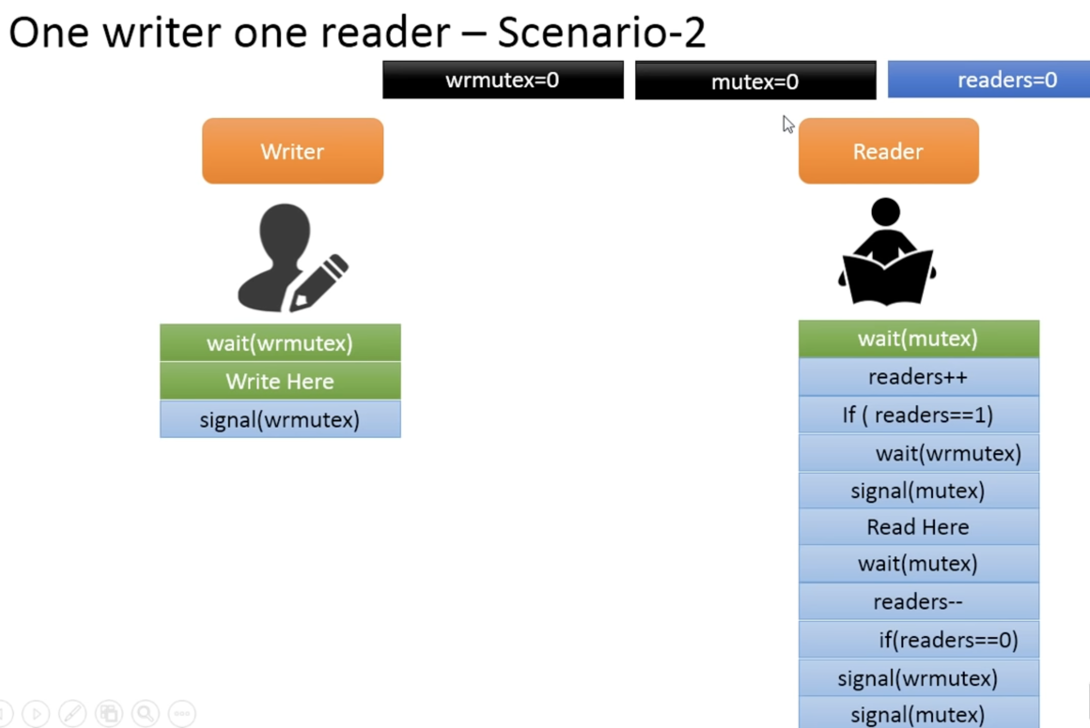

Slide 21
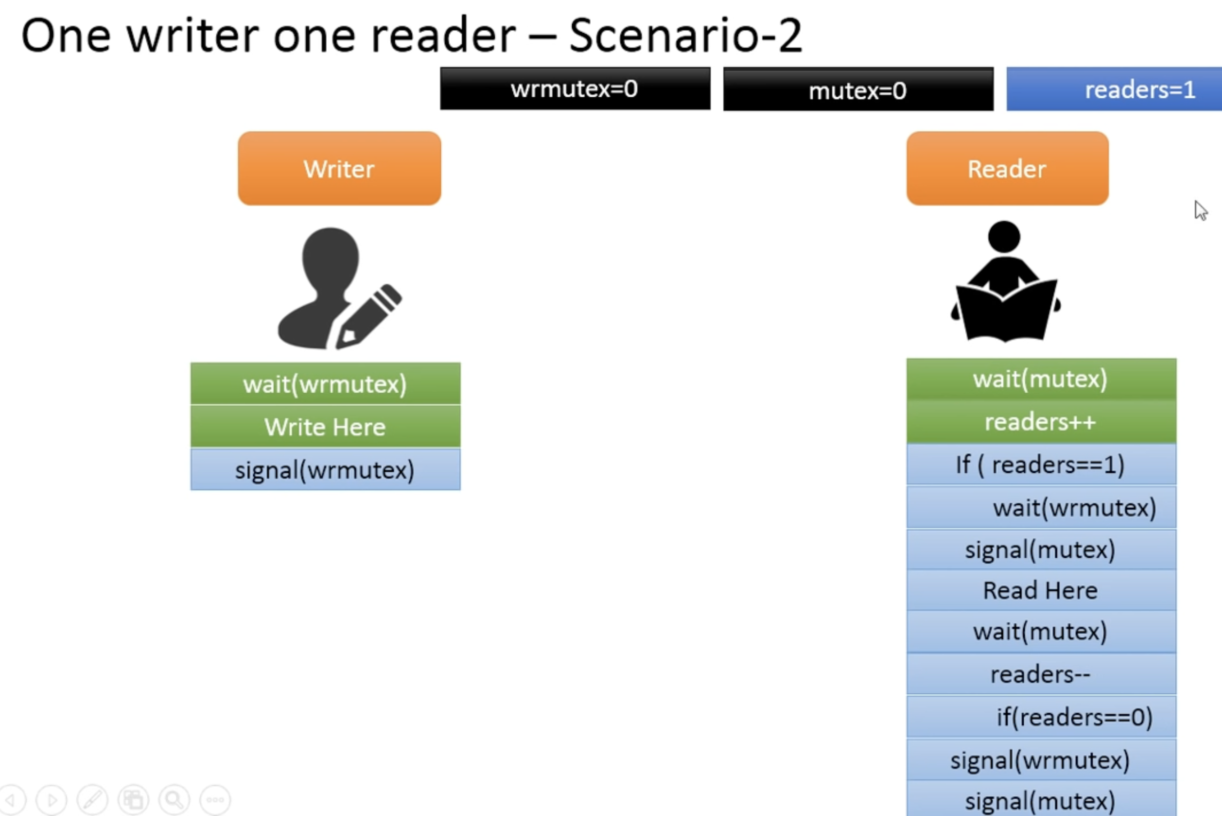

Slide 22
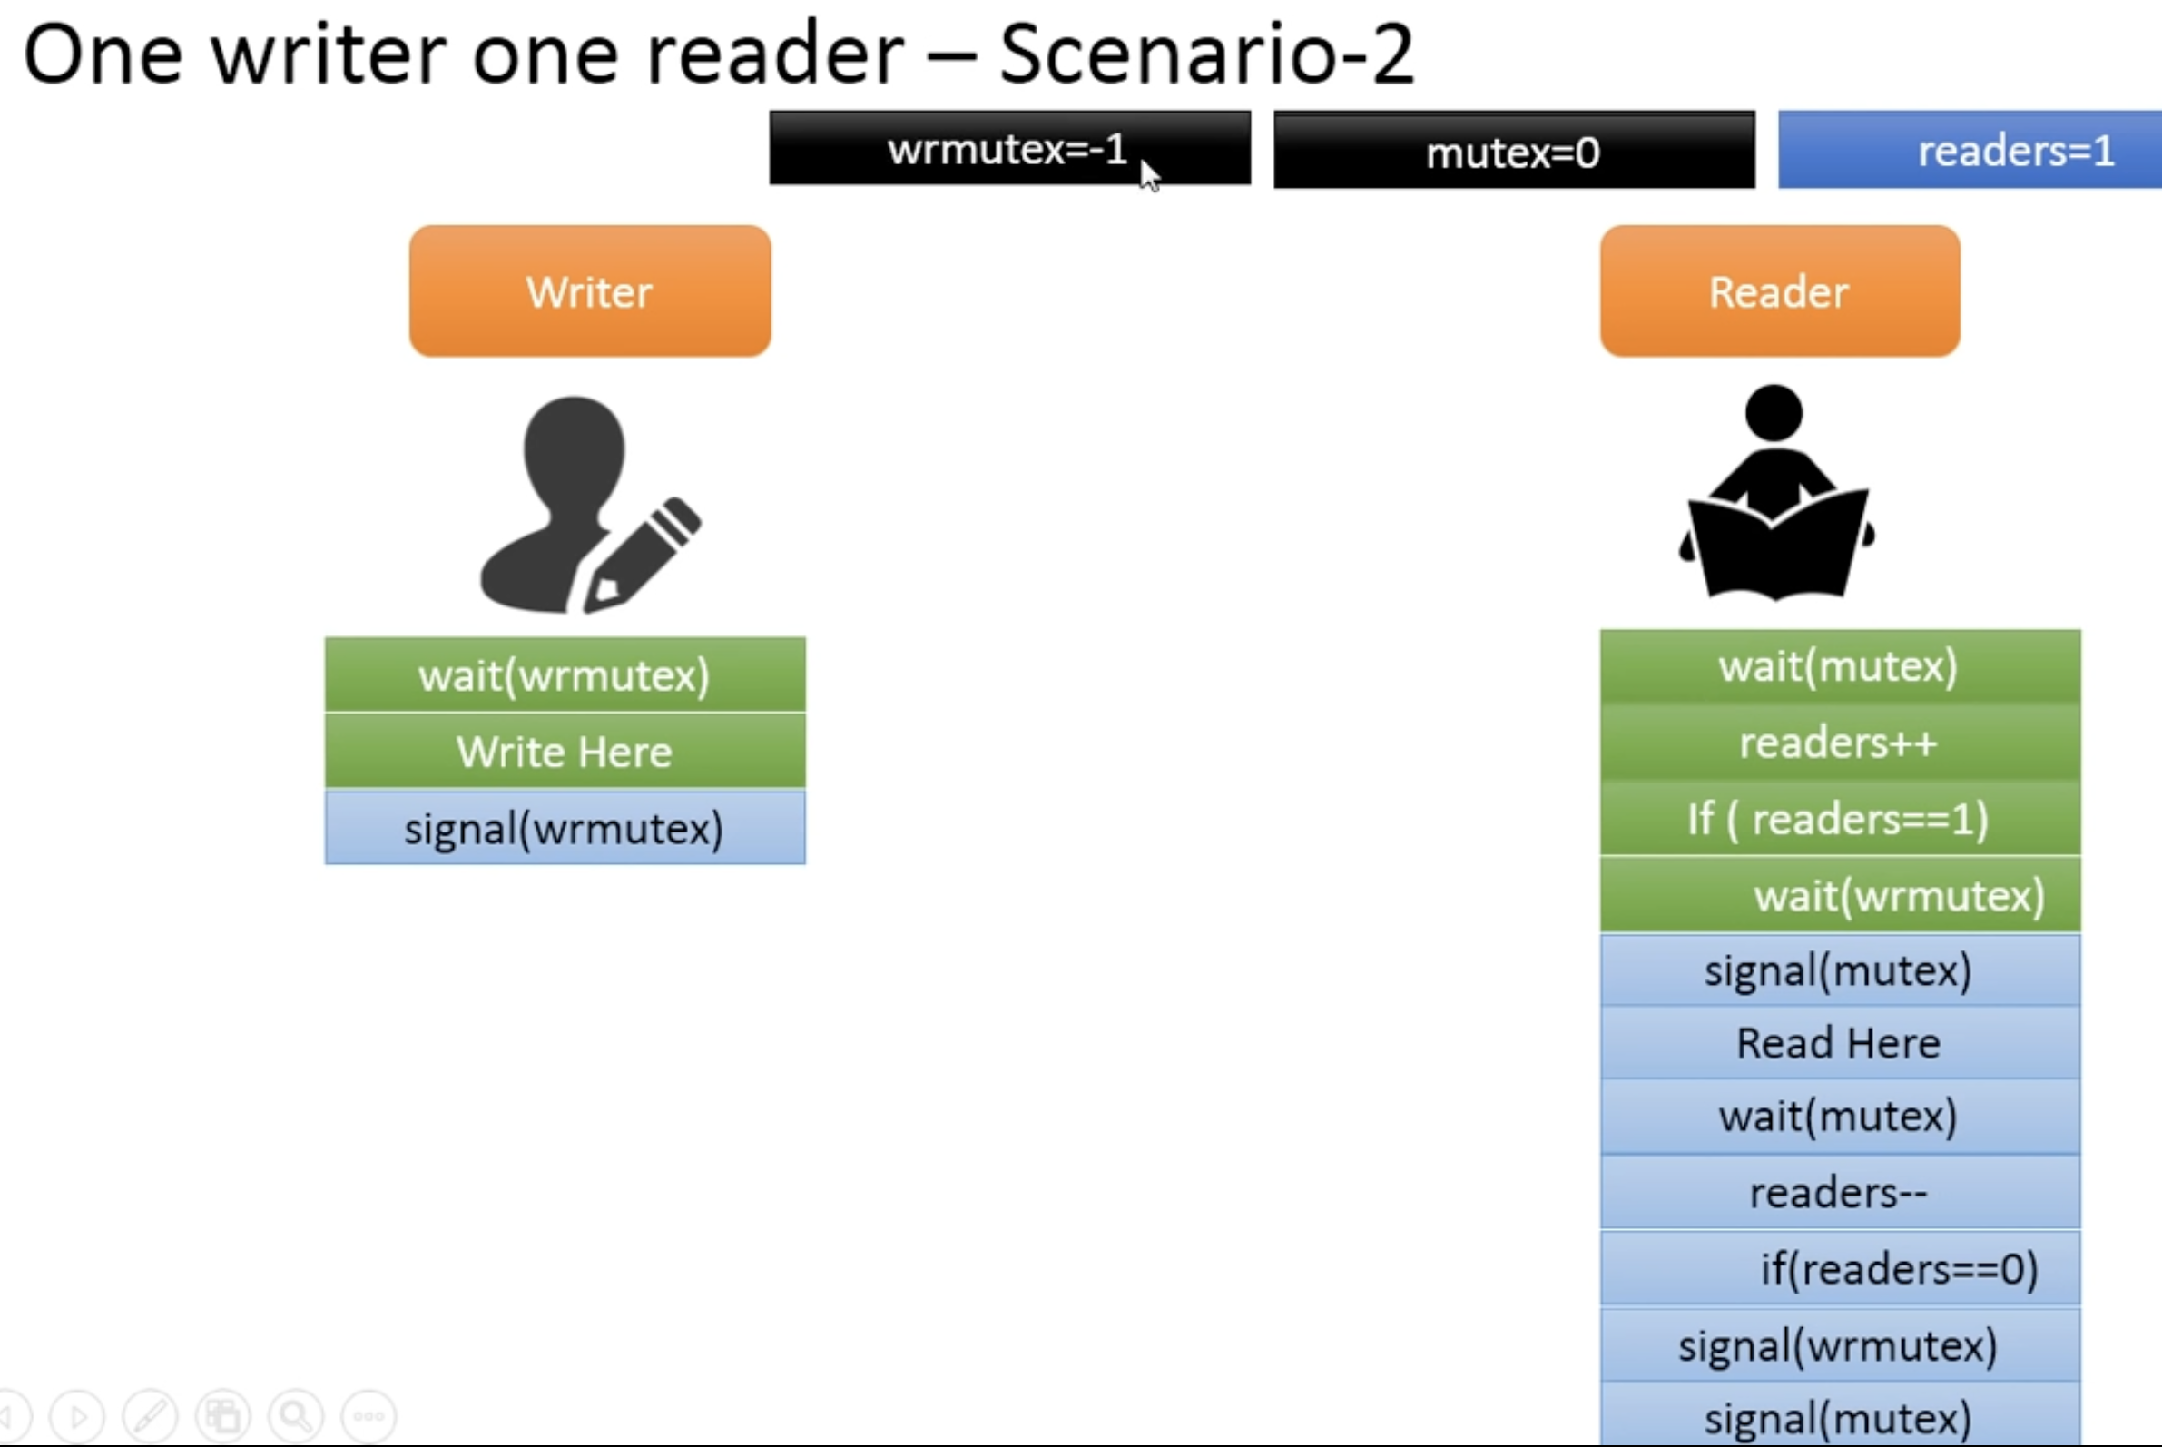

Slide 24
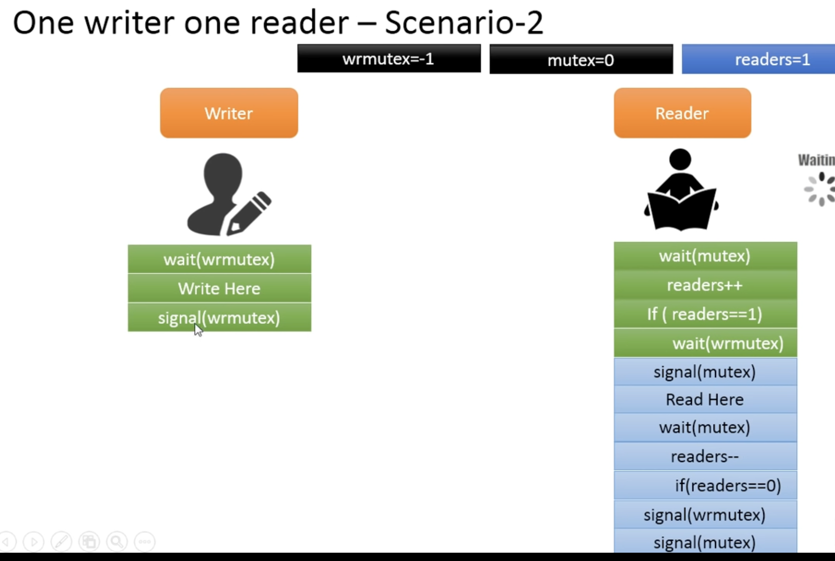

Slide 25
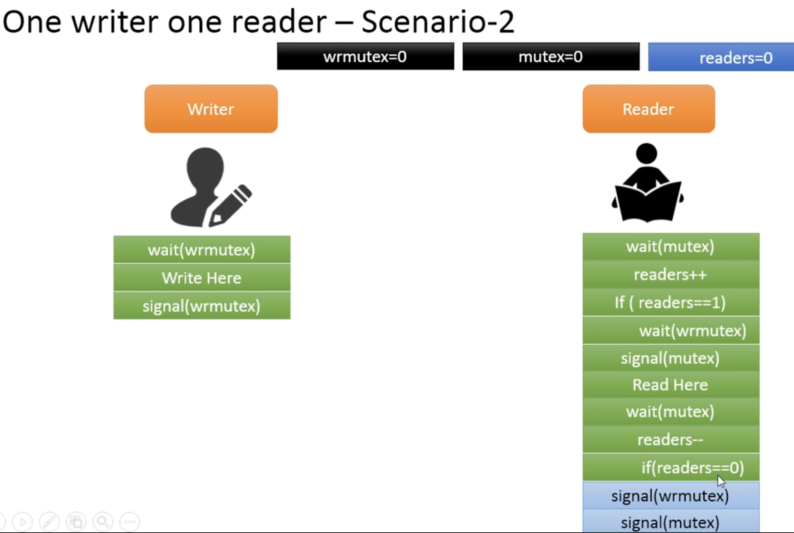

Slide 26
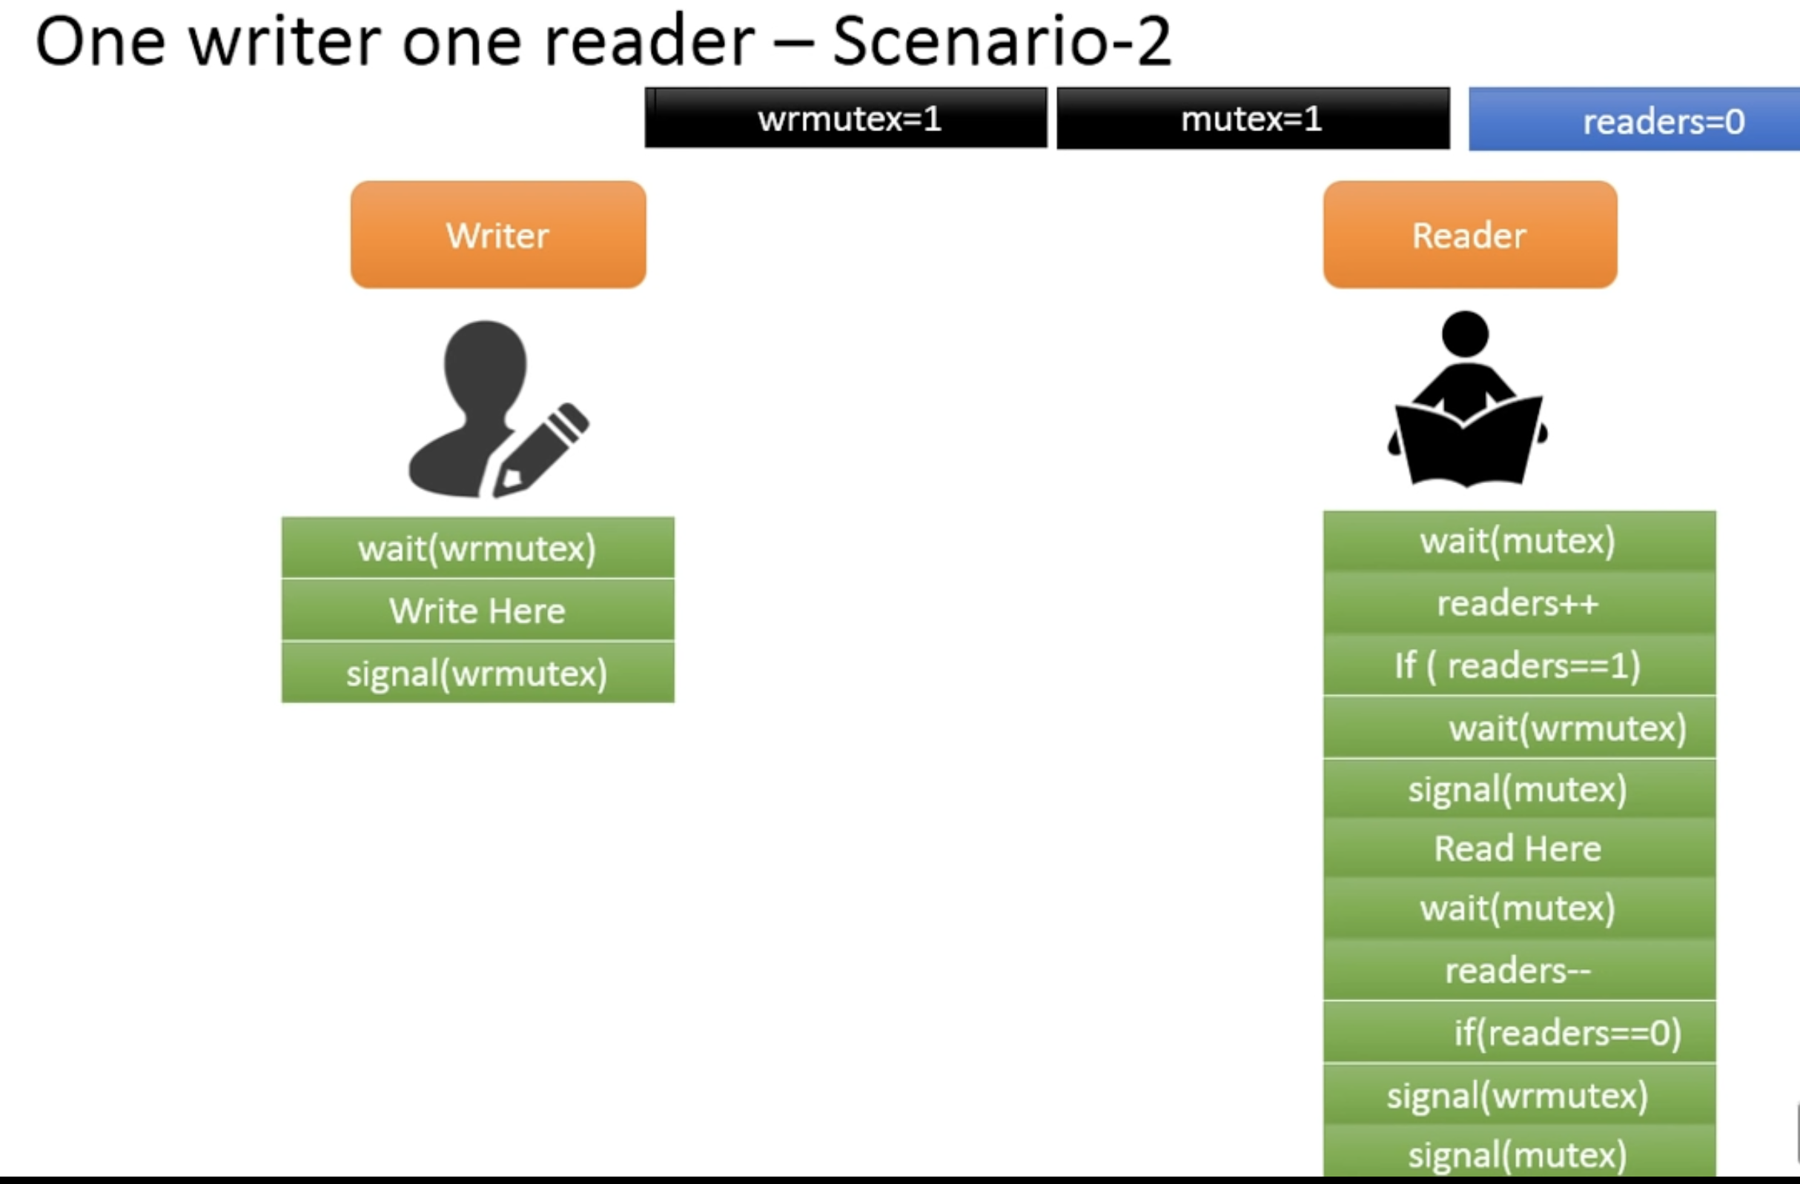

Slide 27
What to Submit ?
A report in PDF ( Details on Canvas )
A tar file that includes:
A makefile for easy compilation. The target executable should be rwmain.
A README file that describes how to run your project (arguments, etc).
A C program, named readerwriter.c, implements the nonstarving locks.
A C program, named main.c, that uses the locks and shows their functionality.

Slide 28
An input file, named scenarios.txt, proves that your lock: ▪ Is a correct readers/writers lock. ▪ Does not starve the writers. ▪ Does not starve the readers.
Each scenario takes one line (as the traces file in the last project)
An example and interpretation of this file are below: rwrrrrwrr wwrrrrwr

Slide 29
You want these scenarios to test corner cases that are relevant to the point of your design: specifically, that writers will not starve.
Thus, you design these test scenarios to make it possible for writers to starve.
You might want to limit each scenario to 10--15 readers and writers at the very most.

Slide 30
Please hardcode the file name for scenarios.txt with the relative path (not the absolute path) in your main.c code, e.g.:
FILE* ptr = fopen("scenarios.txt ","r");

Slide 31
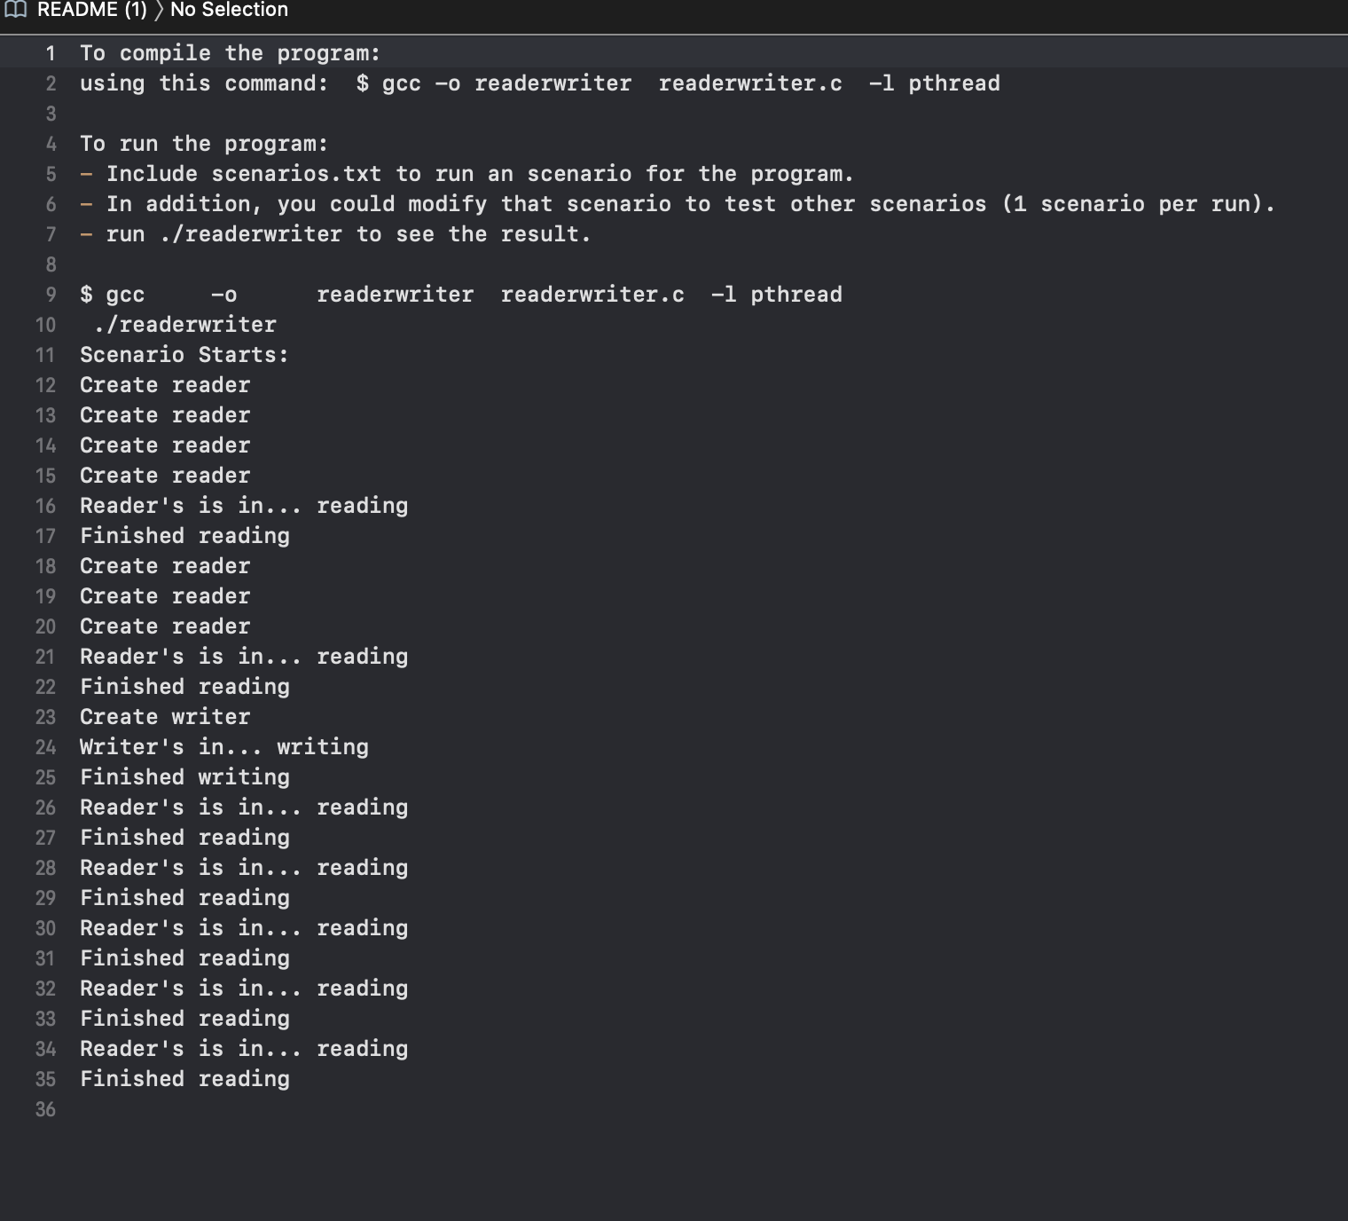
README FILE Contents

Slide 32
Reference Link for code :
GitHub
Textbook

Slide 33

Questions?

